Slide 1
Cybersecurity
Bots and Botnets

Slide 2
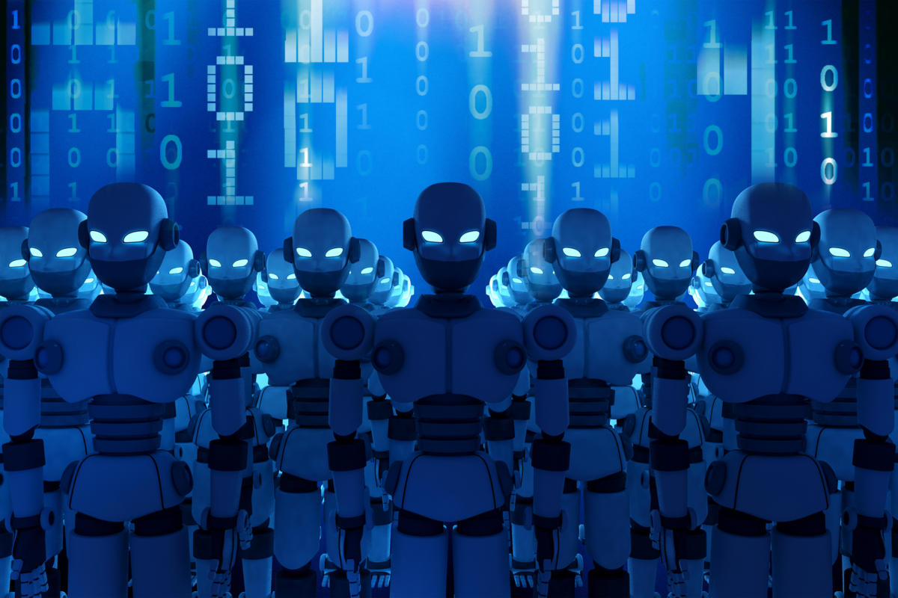
Botnets
Robot networks
Collection of computers able to act as one
Once infected, host computer becomes a “bot”
How does it get on your computer?
Trojan Horse (“Check out this attachment!”) or you run a program or click an ad you THOUGHT was legit
Exploited OS or application vulnerability
Bots sit and wait, phone home (C&C), see if there are any jobs given by the botmaster
“Ping this person”, “Spam these people”, “Visit this site”, “Do this”
Notes:
C&C = “command and control” server

Slide 3
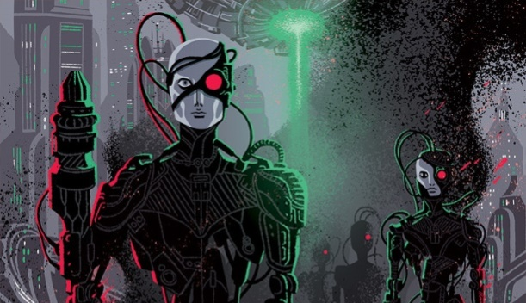
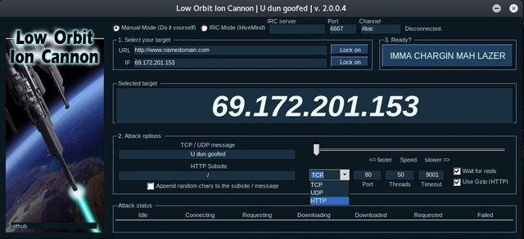
Botnets
Group of bots working together
Distributed Denial of Service (DDoS)
Thousands/millions of machines acting as one
Botnets are leased/for sale
Botmasters rent time on botnet
Often used to send spam

Slide 4

Stop the bot
Prevent initial infection
Update OS and application
Update anti-virus/anti-malware
Identify an existing infection
Scan regularly
Network monitoring, abnormal traffic?
Prevent access to Command and Control (C&C)
Identify with host-based firewall
Block host(s) at the firewall
CVEs will usually provide IP addresses/domain names of C&C servers to block

